Slide 1
Living a Life of Purpose
Encounter Service 10 Dec 2016
Cecil Ang

Slide 2
Quotations
“The purpose of life is a life of purpose.” Robert Byrne
⁷ Though I walk in the midst of trouble, you preserve my life; you stretch out your hand against the wrath of my enemies, and your right hand delivers me.
⁸ The Lord will fulfil his purpose for me; your steadfast love, O Lord, endures forever. Do not forsake the work of your hands. Ps 138:7-8 ESV

Slide 3
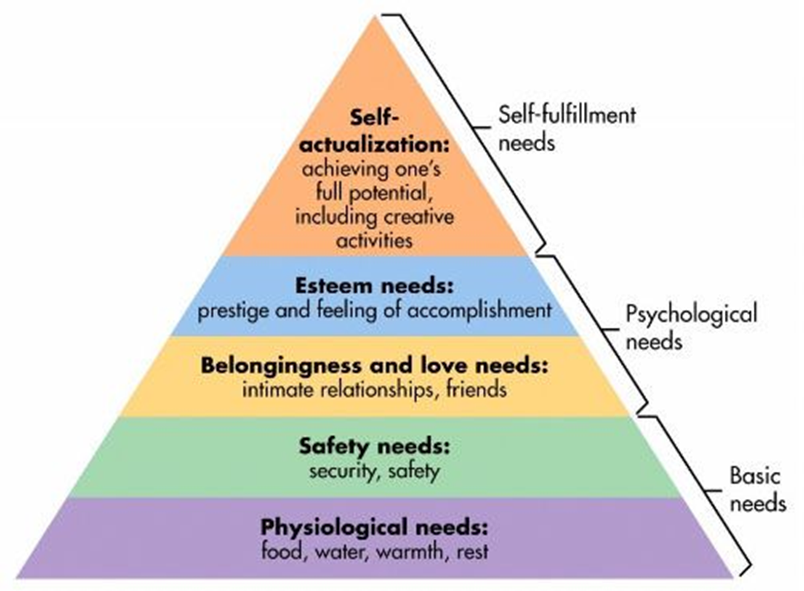
Maslow’s Hierarchy of Needs

Slide 4
What is my purpose for living?
Jesus: “My food is to do the will of him who sent me and to accomplish his work” Jn 4:34 ESV
Paul: “One thing I do – forgetting what lies behind and straining forward to what lies ahead, I press on toward the goal for the prize of the upward call of God in Christ Jesus.” Phil 3:13-14 ESV
Myself: ??
“Let each man find out what God wants him to do, and then let him do it, or die in the attempt.” Charles Spurgeon

Slide 5
Quotes in CSC Toilets
“Our aim is to keep our toilets clean. YOUR AIM WILL HELP”
“We aim to please. YOU AIM TOO PLEASE”

Slide 6
My AIM in life
A: Affirm & Admonish
I: Impact & Influence
M: Magnify & Meditate

Slide 7
Affirm & Admonish
But encourage one another daily, as long as it is called “Today,” so that none of you may be hardened by sin’s deceitfulness. Heb 3:13 NIV
Thoughts
Words & actions
Awards

Slide 8
Affirm & Admonish
¹² We ask you, brothers, to respect those who labour among you and are over you in the Lord and admonish you, ¹³ and to esteem them very highly in love because of their work. Be at peace among yourselves.¹⁴ And we urge you, brothers, admonish the idle, encourage the fainthearted, help the weak, be patient with them all. 1 Thess 5:12-14 ESV

Slide 9
Impact & Influence
¹³ But we will not boast beyond limits, but will boast only with regard to the area of influence God assigned to us, to reach even to you. ¹⁵ We do not boast beyond limit in the labours of others. But our hope is that as your faith increases, our area of influence among you may be greatly enlarged, ¹⁶ so that we may preach the gospel in lands beyond you, without boasting of work already done in another's area of influence.
2 Cor 10:13,15-16 ESV

Slide 10
Impact & Influence
“Leadership is influence – nothing more, nothing less” John Maxwell
The power to influence lies in getting others to participate
Leadership impact increases as influence increases
When a leader has much influence, much can be accomplished
When a leader places family first, future generations will be blessed

Slide 11
Magnify & Meditate
I will praise the name of God with a song; I will magnify him with thanksgiving. Ps 69:30 ESV
Joshua’s influence grew because he was a man of
Prayer – he did not return to camp with Moses but stayed at the tent of meeting (Ex 33:11)
Faith – he stood up against the opinions of the other spies (Num 14:6-10)
Obedience – Joshua obeyed God as a servant, warrior & a leader

Slide 12
Magnify & Meditate
Christians need to be grounded and filled with God:
120 disciples in the upper room (Acs 1-2)
Paul spent 3 years in Arabia (Gal 1:15-18)
¹⁵ But when he who had set me apart before I was born, and who called me by his grace, ¹⁶ was pleased to reveal his Son to me, in order that I might preach him among the Gentiles, I did not immediately consult with anyone; ¹⁷ nor did I go up to Jerusalem to those who were apostles before me, but I went away into Arabia, and returned again to Damascus. Gal 1:15-18

Slide 13
Magnify & Meditate
Only be strong and very courageous, being careful to do according to all the law that Moses my servant commanded you. Do not turn from it to the right hand or to the left, that you may have good success wherever you go. This Book of the Law shall not depart from your mouth, but you shall meditate on it day and night, so that you may be careful to do according to all that is written in it. For then you will make your way prosperous, and then you will have good success. Josh 1:7-8 ESV
Promises/Privileges
Conditions/Responsibilities

Slide 14
Make it your AIM in life
A: Affirm & Admonish
I: Impact & Influence
M: Magnify & Meditate
Grow in your PIES

Slide 15
Poem by C T Studd
Only one life, yes only one,
Soon will its fleeting hours be done;
Then, in ‘that day’ my Lord to meet,
And stand before His Judgement seat;
Only one life,’twill soon be past,
Only what’s done for Christ will last.
Give me Father, a purpose deep,
In joy or sorrow Thy word to keep;
Faithful and true what e’er the strife,
Pleasing Thee in my daily life;
Only one life, ’twill soon be past,
Only what’s done for Christ will last.

